Slide 1

How to Save Your Game in Kodu

Slide 2
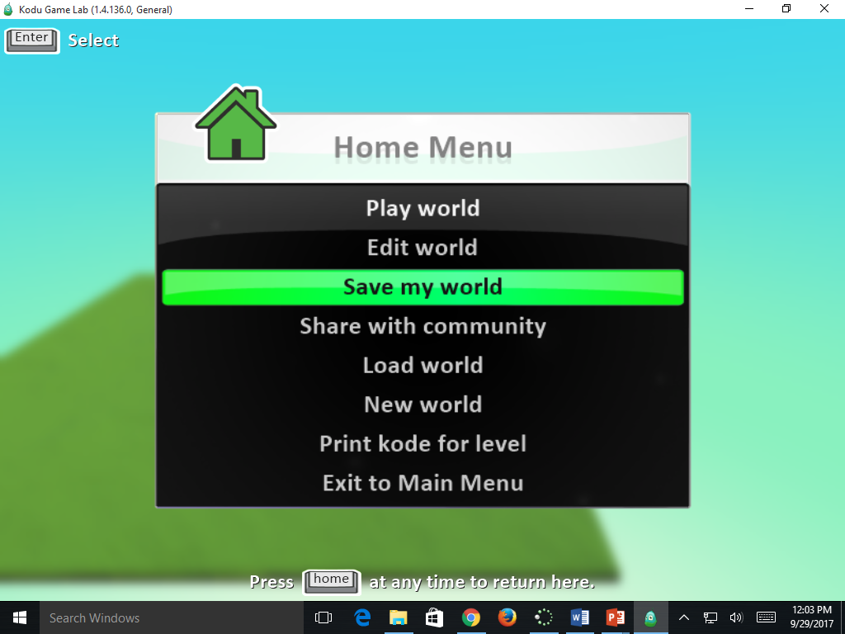
Click Save My World
Click Here

Slide 3
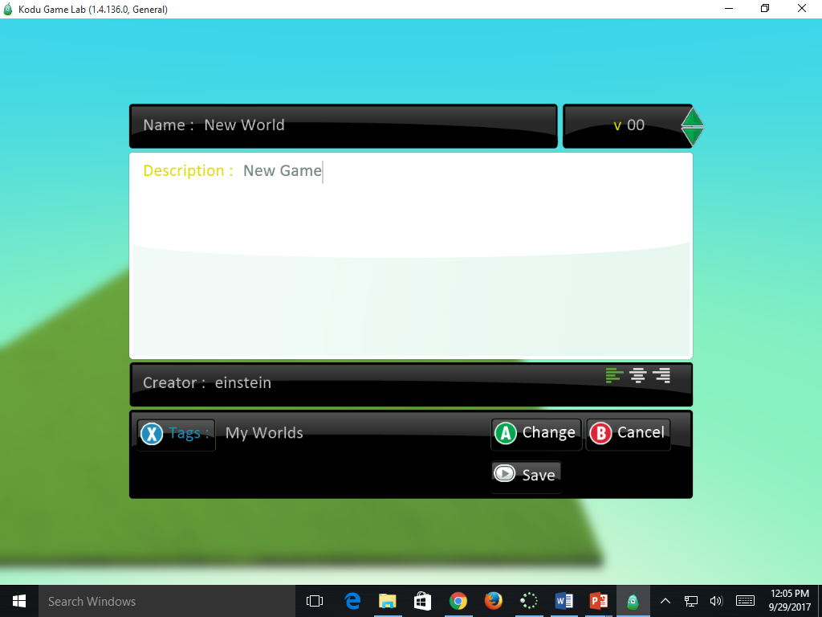
Name Your Game & Save
Name Your Game
Click Save

Slide 4
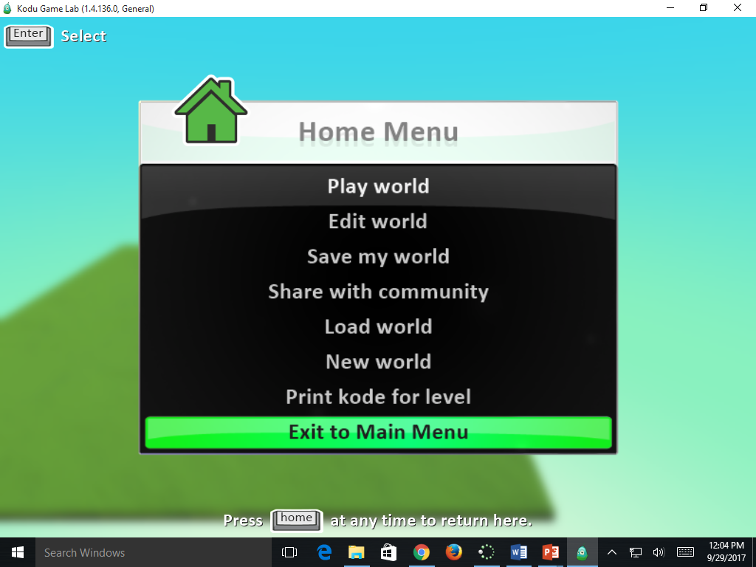
Click Exit to Main Menu
Click here

Slide 5
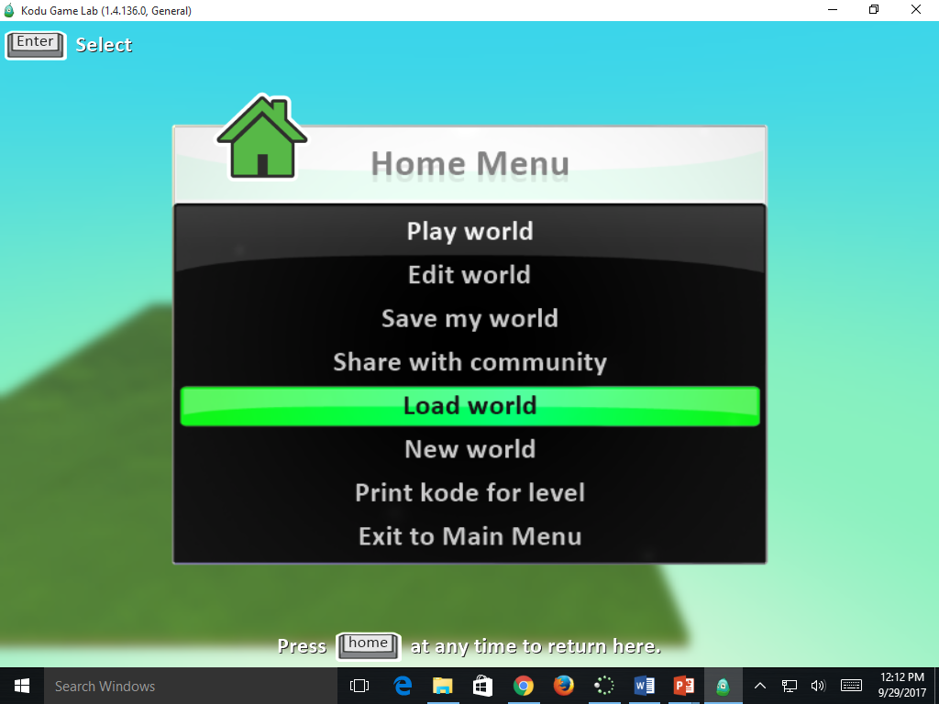
Click Load World
Load Your World

Slide 6
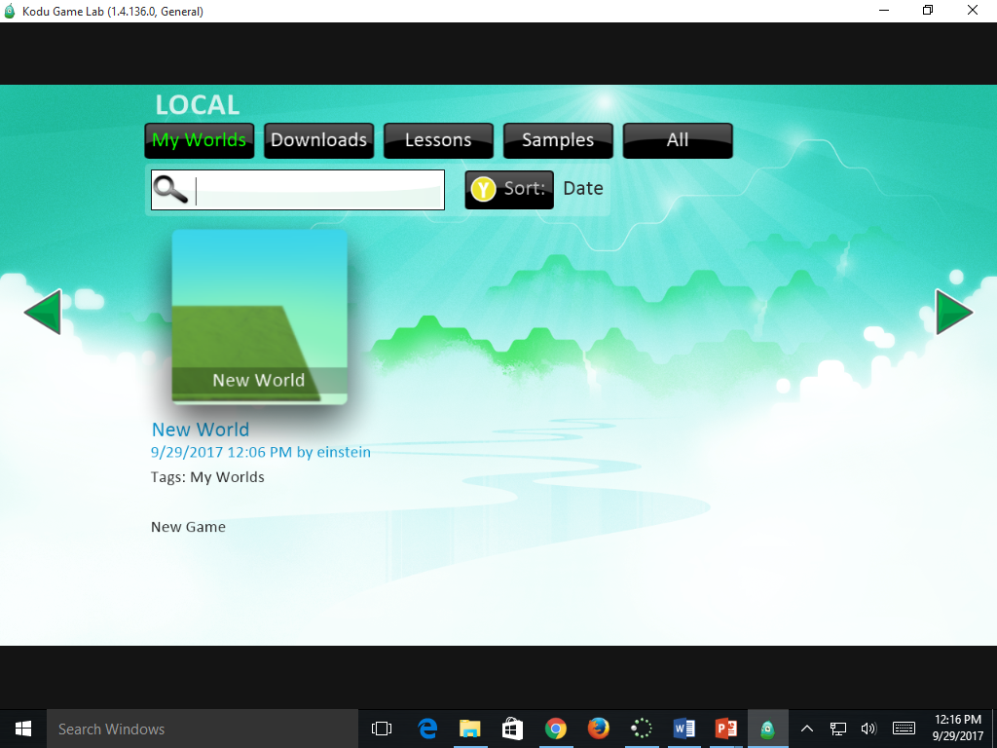
Choose Your Game
Click on Your Game

Slide 7
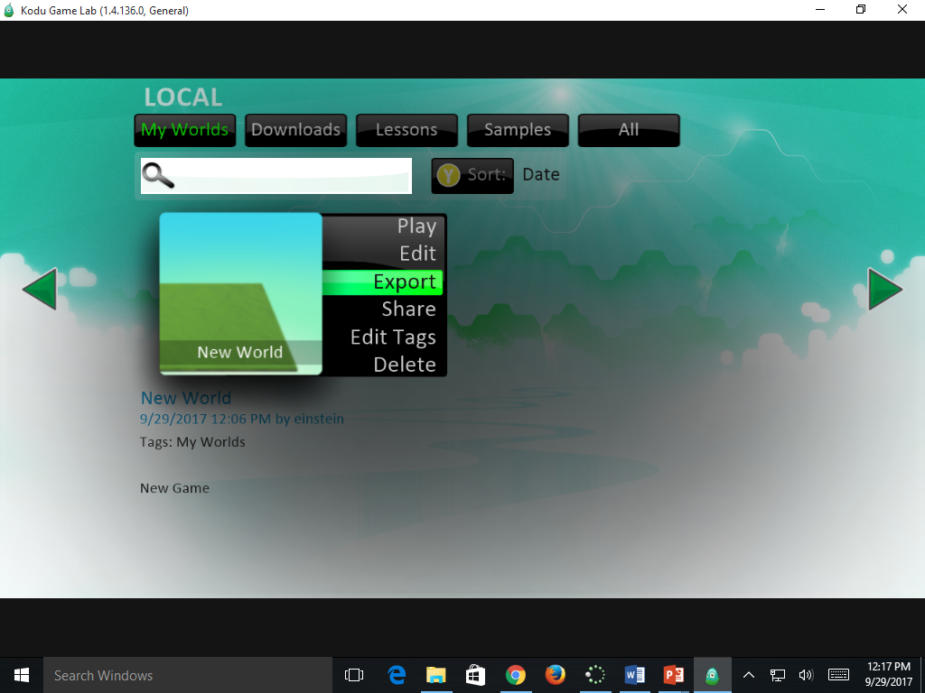
Click Export
Click Here

Slide 8
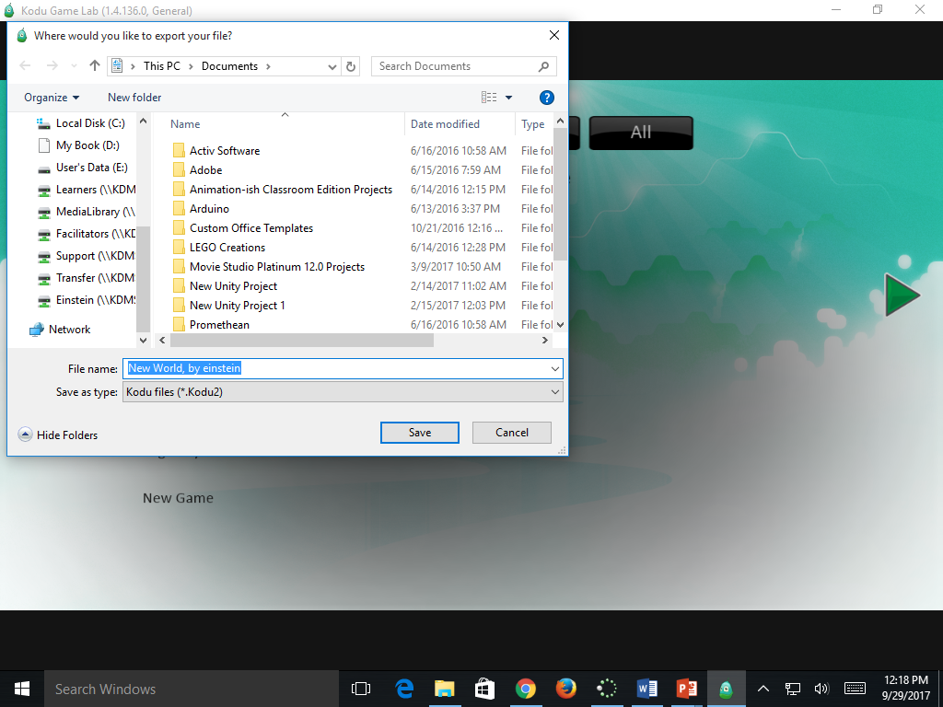
Name & Save to YOUR Learner’s Drive
Save to YOUR Learner’s Drive

